Slide 1

Data Representation
Data Compression
Source / Reference - https://youtu.be/v1u-vY6NEmM

Slide 2
Compression - Reducing the file size for the following reasons:
To save storage space on devices such as hard disk drive / solid state drive.
To reduce the time taken to stream a music or video file.
To reduce the time taken to upload, download or transfer a file across a network.
For faster data transfer rate.
To reduce costs.

Slide 3
Data Compression
Lossy
Lossless

Slide 4
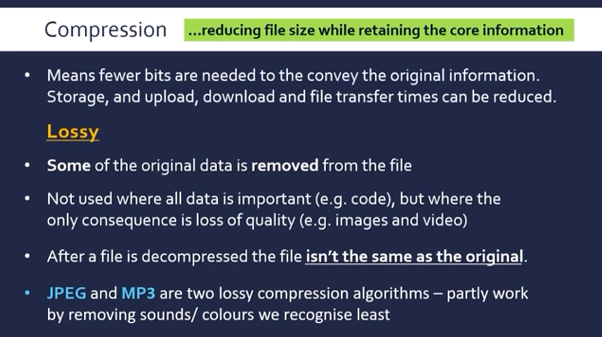
Source: https://youtu.be/v1u-vY6NEmM

Slide 5
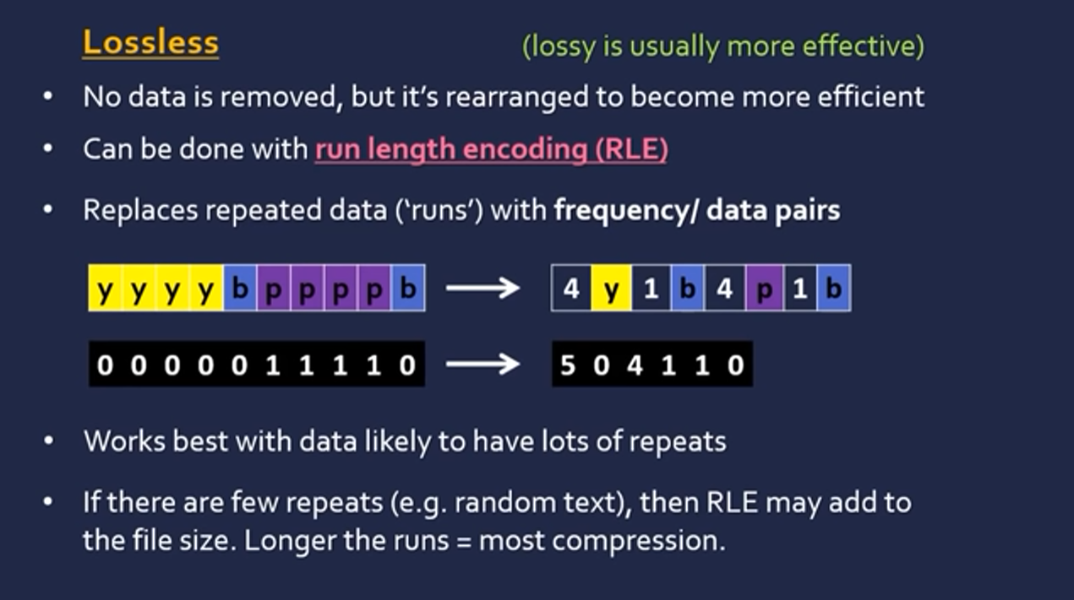
Source: https://youtu.be/v1u-vY6NEmM

Slide 6
Quiz - https://forms.gle/7jcTP4748h2rZBZ4A

